Slide 1
Academic Vocabulary Opener
Academic Vocabulary Word: Use the following organizer as you think about the word: ________________
 | My Understanding: 1 2 3 4
Description: | Visual: | How I make sense of the word:
Definition:

Slide 2
Learning Targets
I can identify, define, and begin to effectively use academic vocabulary in my writing.
I can annotate text to understand author’s purpose and message.
I can convey my thinking, in complete sentences, using proper writing conventions.

Slide 3
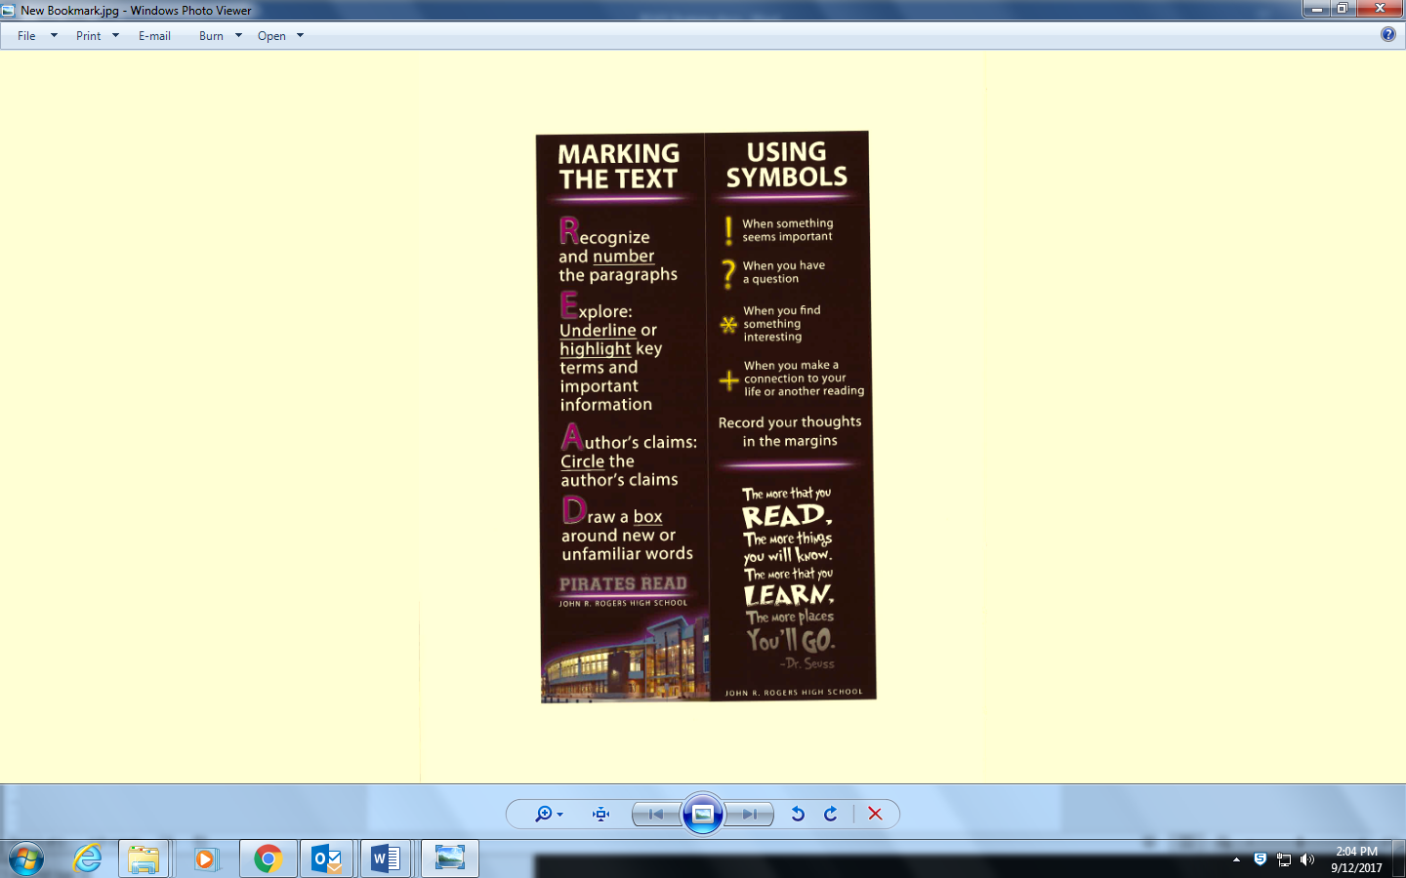
R.E.A.D. Annotation Strategy
(Building-Wide Annotation Bookmarks)
Today’s
focus

Slide 4
Annotation using Symbols &
Writing in the Margins
We use writing in the margins because:
  You actively engage with the text.
  It increases comprehension.
  It will help you remember what is important and what you were thinking as you read the text.
  You won’t have to re-read the whole text when studying.

Slide 5
REMEMBER to use the
R.E.A.D. Annotation Strategy
R: Number the paragraphs.
E: Explore and circle key terms and important points.
A: Underline the author’s claims and relevant information.
D: Draw a box around new or unfamiliar words.
We will number the paragraphs together. The title is paragraph 1.

Slide 6
REMEMBER to use the
Symbols and Write in the Margins
! - When something seems important
? - When you have a question
* - When you find something interesting
+ - When you make a connection to your life or another
reading
Reading- Complete the READ strategy and the “Using Symbols” Annotation Strategy while writing in the margins.
Write 3 annotations using 3 different symbols. ! ? * +

Slide 7
3 Sentence Writing Activity
(But, So, Because)
Sometimes we write summary sentences that are too simple and don’t provide enough evidence to support them.
To address this, we are going to take more simple sentences and make them more complex and, as a result, better summary sentences.

Slide 8
3 Sentence Writing Activity (But, So, Because)
But……change of direction
So……..cause and effect
Because…tells why

Slide 9
3 Sentence Writing Activity (But, So, Because)
Simple Sentence Examples
Provide three simple sentences based in the text that students can provide detail using but, so, and because.

Slide 10
3 Sentence Writing Activity (But, So, Because)
Complex Sentence Examples
Use each of the simple sentences provided on slide 9 and show how to use but, so, and because as an example for students.

Slide 11
Find your “Sole” Mate
1. Once you have found your new partner, work together to Craft a sentence using “but” as a conjunction.
2. Craft two more sentences using “so” and “because”
3. Be ready to share a sentence you created if your name is called.

Slide 12

Closer:
What’s next?
Based off of today’s targets, predict the purpose for using the R.E.A.D. strategy in future classes.
Predict how this strategy will help you comprehend texts in this class and in your other classes.

Slide 13
Collecting Work
Please make sure your name is on the article and the handout.
I will be collecting both.

